Slide 1
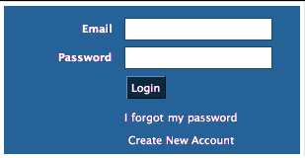
Le conditionnel présent
Hello my name is Sofie. Welcome to Mme. Le Blanc’s grade 10 online lesson
Notes:
Welcome to our web-based learning tool entitled “Le conditionnel présent”. As you can see by the avatars speech bubble, this course is intended for grade 10 core French courses. In this screen students will be prompted to log-in and see the following screens.

Slide 2
SCREEN TITLE
Course Menu
Brief introduction to page content
Home Page
Explanation of Activity
Previous
Next
Resources
Tips
Page X of X
Notes:
This is an outline of what the students will see on the following screens. The screen shows various orienting features and easy navigational tools. Sofie, the avatar will guide students through their learning and activities and prompt them when needed. The orange bar will only appear on screens where the learner is acquiring knowledge where as the purple bar will only appear on screens where the learner is engaged in activities. The resources button will open up a new window with a list of websites, videos and other online resources similar to the content being taught. The tips button is a rollover feature that gives learner helpful hints for that page. This web-based learning tool encompasses the ARCS model, social development theory, and situated learning theory. Throughout the web-based learning tool, the multimedia principal is prevalent as the tool includes both words and graphics that are simple, relevant, and consistent. In addition, the WBLT is broken down into various segments and there is no extraneous audio, graphics, and words. This ensures that the user is not overloaded with information.

Slide 3
SCREEN TITLE
Course Menu
Home Page
At the end of this session, you will know….
how to conjugate the conditional present
how to use the conditional present in the proper contexts
At the end of this session, you be able to...
Use your knowledge of the conjugations and usage of the verb tense in your formative tasks and your final culminating assignment
Welcome Diana
Previous
Next
Resources
Tips
Page X of X
Notes:
This screen will give an overview of students learning objectives. Note that the avatar personally addresses the student based on their log-in information.

Slide 4
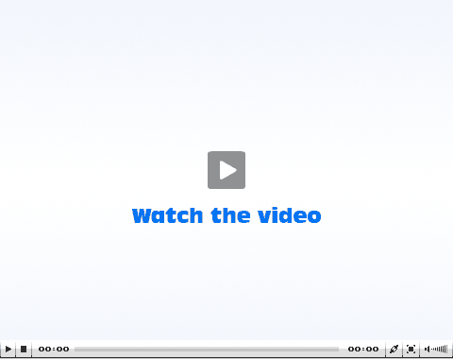
SCREEN TITLE
Course Menu
Brief introduction to page content
Home Page
Previous
Next
Resources
Tips
Page X of X
Notes:
On this screen students will watch a video on two people talking about going on a trip to Quebec and the using conditionnel present. This will add significantly to their learning process. This is an example of situated learning where the learning is through a real world environment. The learning here is situated within the context.

Slide 5
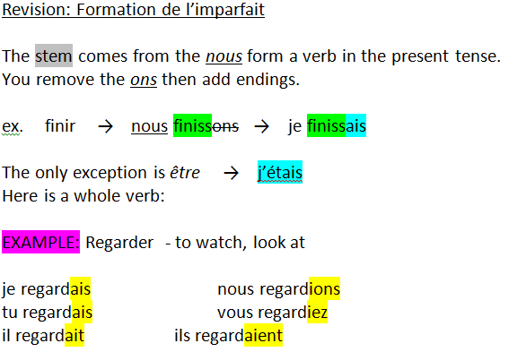
SCREEN TITLE/
Course Menu
Brief introduction to page content
Home Page
Example of content
Previous
Next
Resources
Tips
Page X of X
Notes:
On this screen, students will read over the given information on how to use the imperfect tense.

Slide 6
SCREEN TITLE
Course Menu
Explanation of Activity
Home Page
Je
Parler
Nous
Entrer
Tu
Finir
Vous
Partir
Il/Elle
Rire
Ils/Elles
Dire
Les terminaisons:
aient
ions
ait
ais
ais
iez
Previous
Next
Resources
Tips
Page X of X
Notes:
On this screen, students will be engaged in an interactive drag and drop activity that allows them to use their knowledge from the previous screen. Students will click on the explanation of activity button for instructions on how to complete the activity. If a student is unsure of the answers, they can click on the avatar for helpful hints. At the end of the activity, the avatar will give them feedback if needed, as per social development theory. This feedback will guide the learner while using the tool.

Slide 7
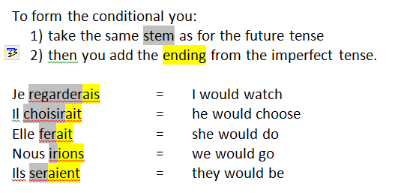
SCREEN TITLE
Course Menu
Brief introduction to page content
Home Page
Example of content
Previous
Next
Resources
Tips
Page X of X
Notes:
On this screen, the avatar will explain that now they’ve masters the imperfect tense, they will now learn how to conjugate the conditionnal present tense.

Slide 8
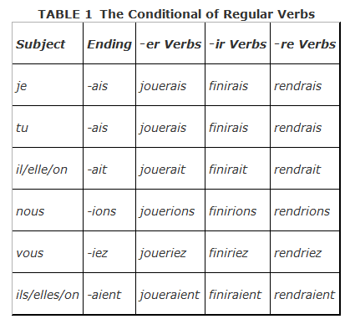
SCREEN TITLE
Course Menu
Brief introduction to page content
Home Page
Example of content
Previous
Next
Resources
Tips
Page X of X
Notes:
After learning the rules for conditionnnal present, students will see how to apply the rule they’ve learned to verbs with different endings.

Slide 9
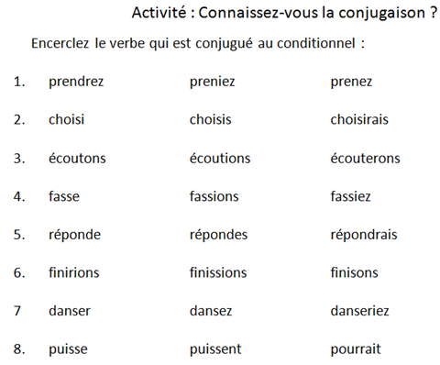
SCREEN TITLE
Course Menu
Home Page
Previous
Next
Resources
Tips
Page X of X
Notes:
On this screen, students are applying the knowledge they’ve learnt in the previous screen by recognizing the correct ending for the verb.

Slide 10
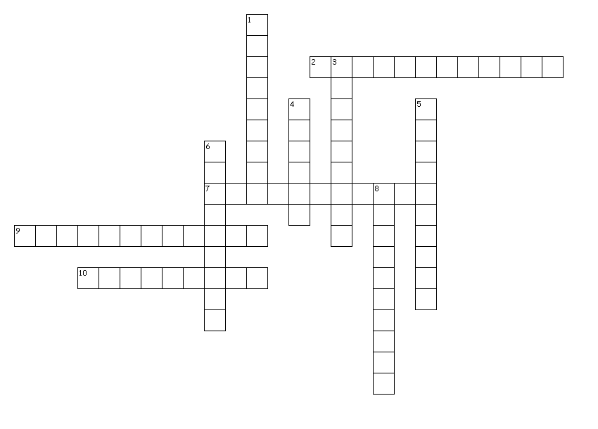
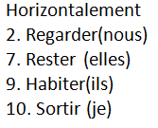
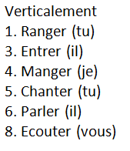
SCREEN TITLE
Course Menu
Explanation of Activity
Home Page
Previous
Next
Resources
Tips
Page X of X
Notes:
On this screen, students will be engaged in an interactive crossword puzzle activity.

Slide 11
SCREEN TITLE
Course Menu
Explanation of Activity
Home Page
Previous
Next
Resources
Tips
Page X of X
Notes:
On this screen, students will be engaged in an interactive activity where they are given the option of choosing any 5 countries they want to create conditionnal present sentences. The ARCS model is applicable here as the countries grabs the students attention, the learning is relevant and motivates them to learn, the avatar will guide the students to ensure success, and the students will be satisfied because they have a choice of countries to choose from.

Slide 12
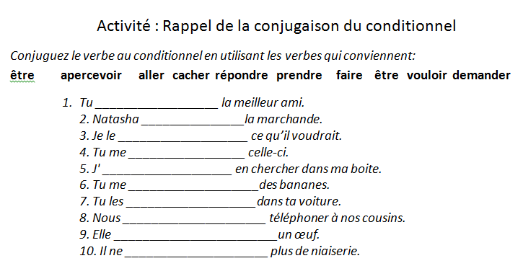
SCREEN TITLE
Course Menu
Home Page
Previous
Next
Resources
Tips
Page X of X
Notes:
On this screen, students will be given 3 activities that they can choose from. One would be to fill in the blanks. These type of activities help test students understanding of the conditionnal present while they are still being guided by the avatar.

Slide 13
SCREEN TITLE
Course Menu
Home Page
Previous
Next
Resources
Tips
Page X of X
Notes:
This would be the last screen that congratulates the student on their completion of the online lesson and they will be presented with a personalized certificate of completion.

