Slide 1
Social Media in the Classroom
Using Online Learning in the Classroom
Presented by: Bavina, Candida, Roshni, Safia and Sasha
EDUC5103 - Online Technology in Education

Slide 2
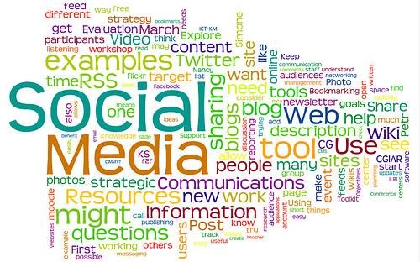

Slide 3
Agenda for Tonight
Introduction by Sasha
Definition and timeline by Safia
Roshni: what are the "pros" of using social media in the classroom?
Bavina: what are the "cons" of using social media in the classroom?
Sasha: discussing blogging in the elementary classroom
Candida: examining the use of Twitter in the secondary classroom
Safia: looking at how Skype can be incorporated into classroom pedagogy
Wrap-up and Discussion

Slide 4

Let's start the conversation

Slide 5

So⋅cial me⋅di⋅a [soh-shuh l] [mee-dee-uh] –noun
1.media designed to be used through social interaction
2.supports the human need for social interaction, using Internet- and web-based technologies (web 2.0)
3.transforms broadcast media monologues (one to many) into social media dialogues (many to many)
4.supports the democratization of knowledge and information, transforming people from content consumers into content producers, also referred to as social media as
1. user-generated content (UGC) or
2. consumer-generated media (CGM)

Slide 6
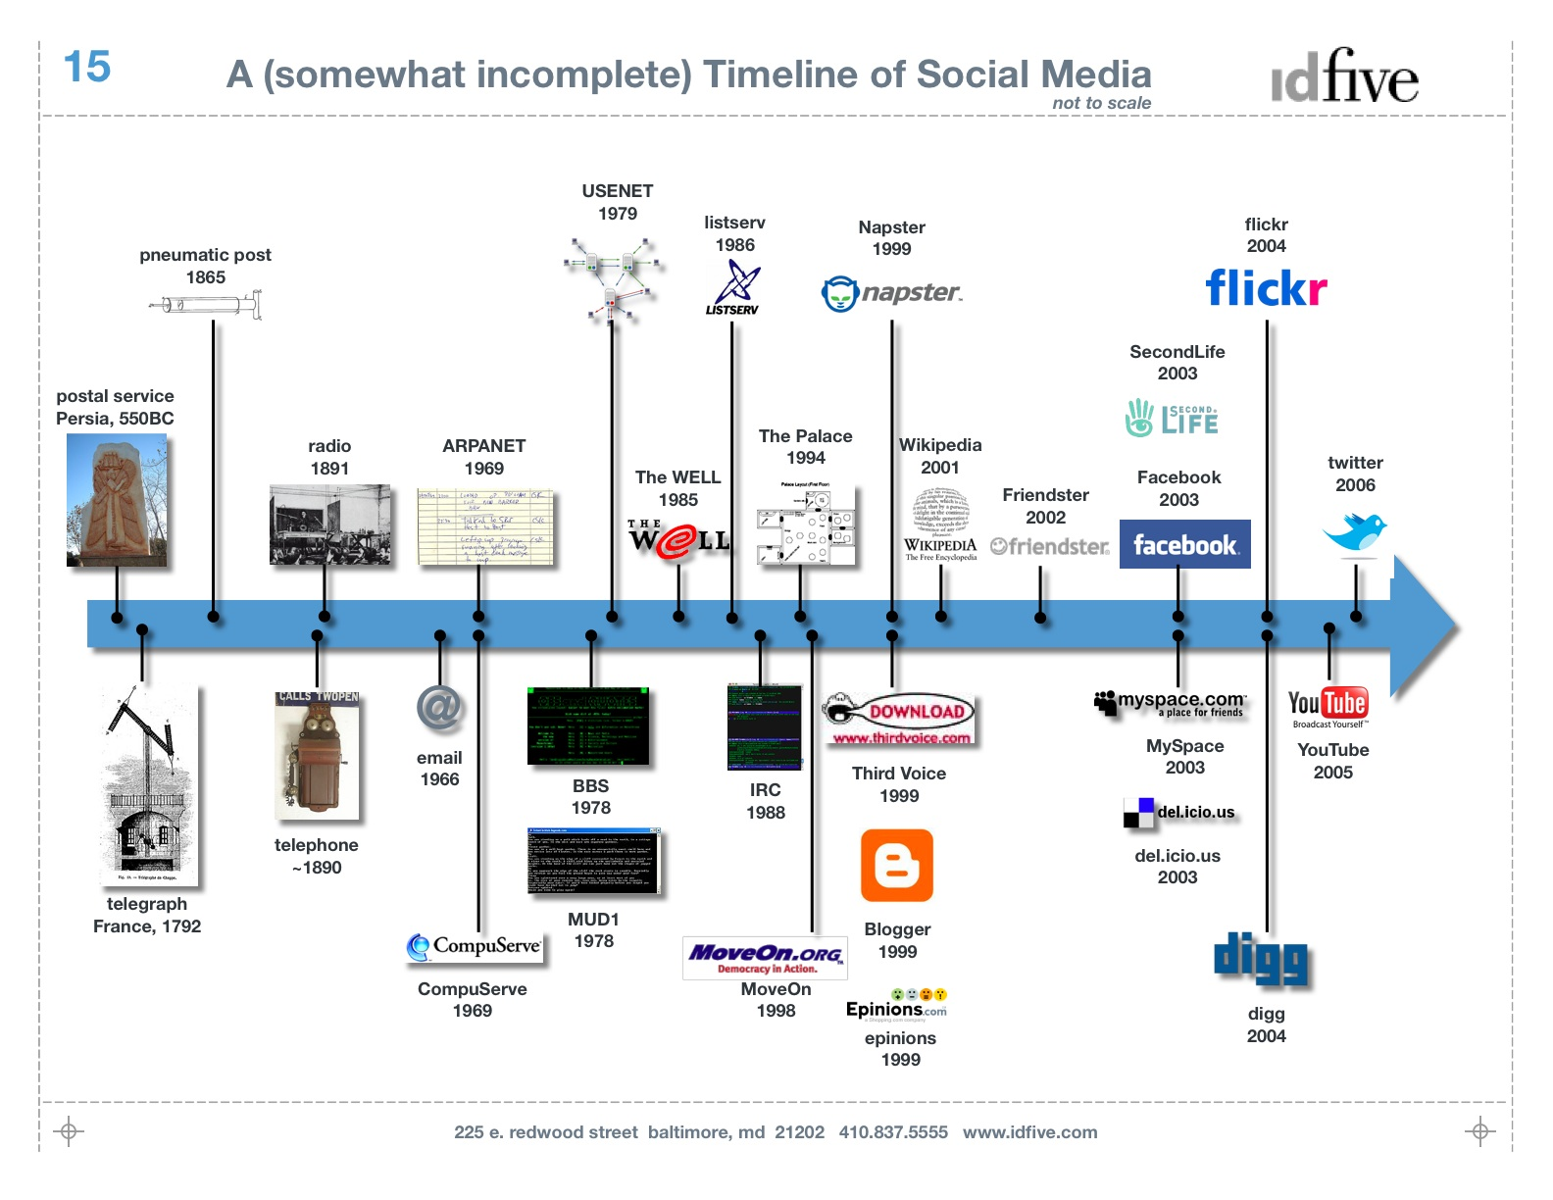
Social Media Timeline

Slide 7
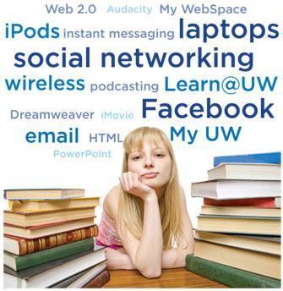
The "Pros" of Using Social Media as a learning tool in the Classroom
1.) It is a familiar tool.

Slide 8
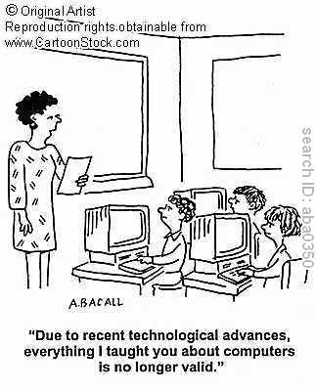
The "Pros" Continued...
2.) Improve your own knowledge and skills

Slide 9
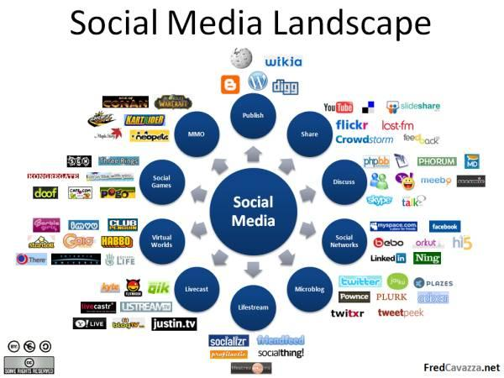
The "Pros" Continued...
3.) Resource availability.

Slide 10
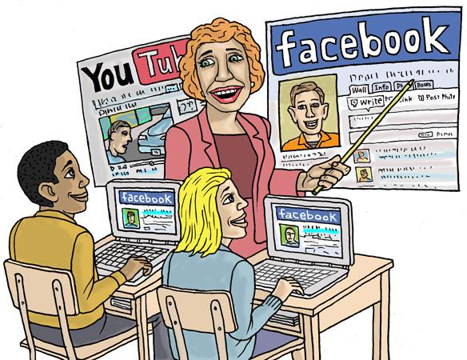
The "Pros" Continued...
4.) The improvement of communication.

Slide 11
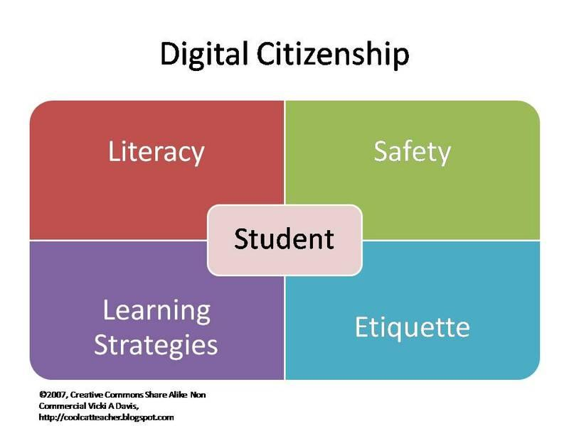
The "Pros' Continued...
5.) The promotion of digital citizenship.

Slide 12
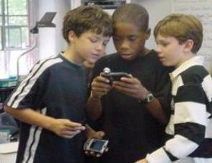
The "Pros" Continued...
6.) Engaging your students.

Slide 13

The "Pros' Continued...
7.) The ability to share learning material.

Slide 14
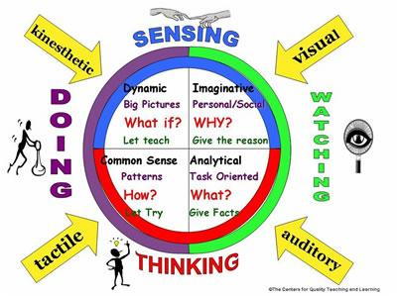
The "Pros" Continued...
8.) The potential to appeal to different learning styles.

Slide 15
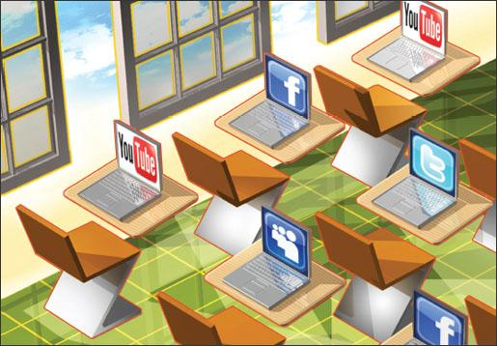
The "Pros' Continued...
9.) Ease of access.

Slide 16

The "Pros" Continued...
10.) Assisting shy students.

Slide 17

The "Cons" of Using Social Media as a learning tool in the Classroom
1) Distractions

Slide 18

"Cons" Continued
2) Cyberbullying

Slide 19

"Cons" Continued
3) Limiting face-to-face communication

Slide 20

"Cons" Continued
4) Continual social media change

Slide 21

"Cons" Continued
5) Controlling device use in class

Slide 22
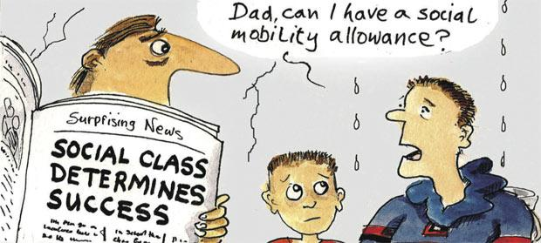
"Cons" Continued
6) BYOD = Division of Social Class?

Slide 23
HOWEVER...
http://www.youtube.com/watch?v=3zKdPOHhNfY

Slide 24
Blogging in the Classroom
Quick Poll: "Does anyone currently use a class blog in their classroom?"
Discussion: Why or Why Not?
So what is a Blog? (in case you didn't already know...)
essentially this is a web publishing tool that allows users (in this case students and teachers alike) to self-publish their work
entries are treating almost like a diary entry, and can be quick and include pictures and other content
most blogs are user-friendly and require minimum effort to create and maintain

Slide 25
Benefits of Blogging
blogging is very motivating to students
allows students to practice their literacy skills
students can collaborate with each other in a different environment than the classroom
most students already use e-mail and web messaging, so blogging can be regarded as an extension to this type of communication
teachers can incorporate cross-curricular activities
students actually engage in meaningful activities that are FUN without realizing that they are learning!

Slide 26
Why I think Blogging is great!
Aside from the other benefits mentioned, blogging is great because:
it allows students to use technology that they may not normally have access to
introduces students to the Web 2.0 - which is something they will be interacting with and using more and more as they get older
lets students who do not "like" writing in the traditional way explore literacy in a different medium
kids respond to blogging enthusiastically, and I find that students access the blog from home
since students already use these types of websites and services, I find that I actually learn from them!

Slide 27
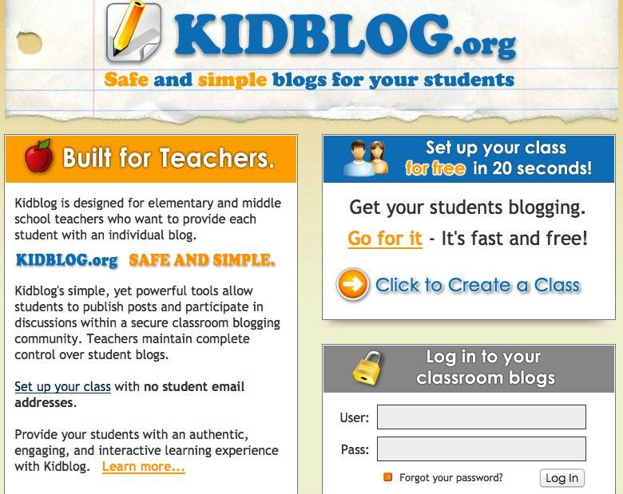
What I Use in my Classroom

Slide 28
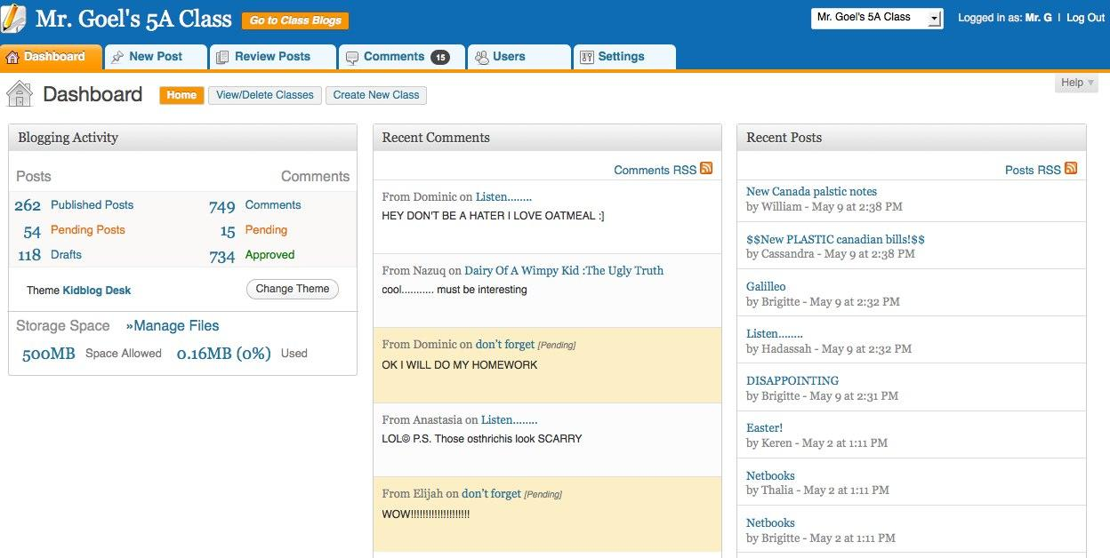
The Dashboard...

Slide 29
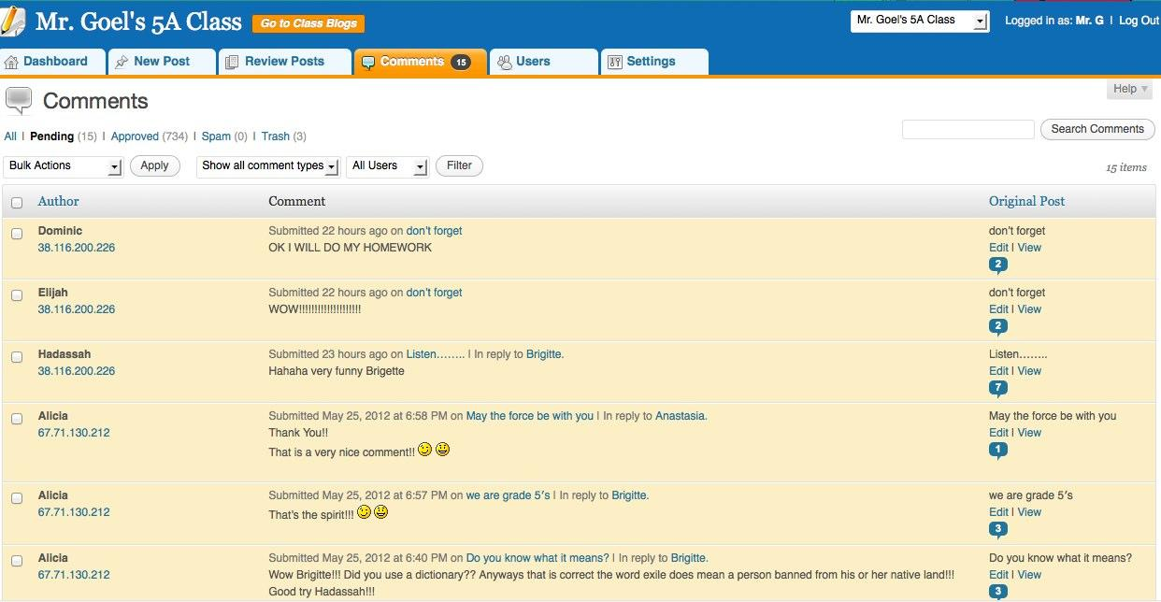
Approving Posts

Slide 30
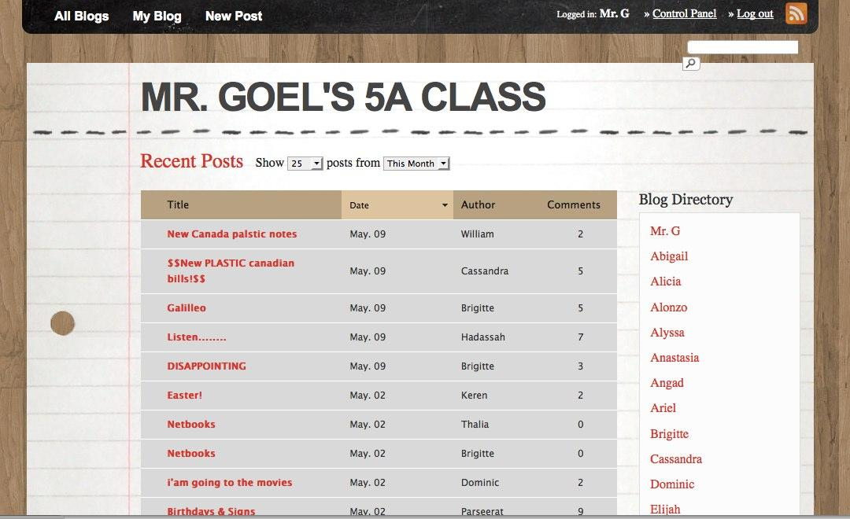
The Finished Product!

Slide 31
Does it Work?
My students are constantly asking if we will be working on our class blog today
students who are shy in class are very active and participate effectively in the blog
students enjoy the less formal writing voice it encouraged, the inherent interactivity in in the assignment, and being able to read other students' ideas and getting feedback on their own (Ellison & Wu, 2008)
I have noticed that assignments given on the blog are completed more thoroughly and with more interest by the students

Slide 32
For More Information...
This is a great video that describes how to create a blog on Kidblog.org
http://www.youtube.com/watch?v=UKhMeHcCG_8
10 Reasons Your Students Should be Blogging (observations by a teacher on his own blog)
http://photomatt7.wordpress.com/2011/10/01/reasons-to-blog/
References:
Ellison, N. B., & Wu, Y. (2008). Blogging in the Classroom: A Preliminary Exploration of Student Attitudes and Impact on Comprehension. Journal Of Educational Multimedia And Hypermedia, 17(1), 99-122.

Slide 33
Social Media is...
•Is cost efficient
•Offers numerous ways to communicate
•Offers instructional benefits
•Allows us to create networks
•Allows us to create groups
•Allows us to use chat functions
•CREATES CONVERSATIONS!!!!

Slide 34
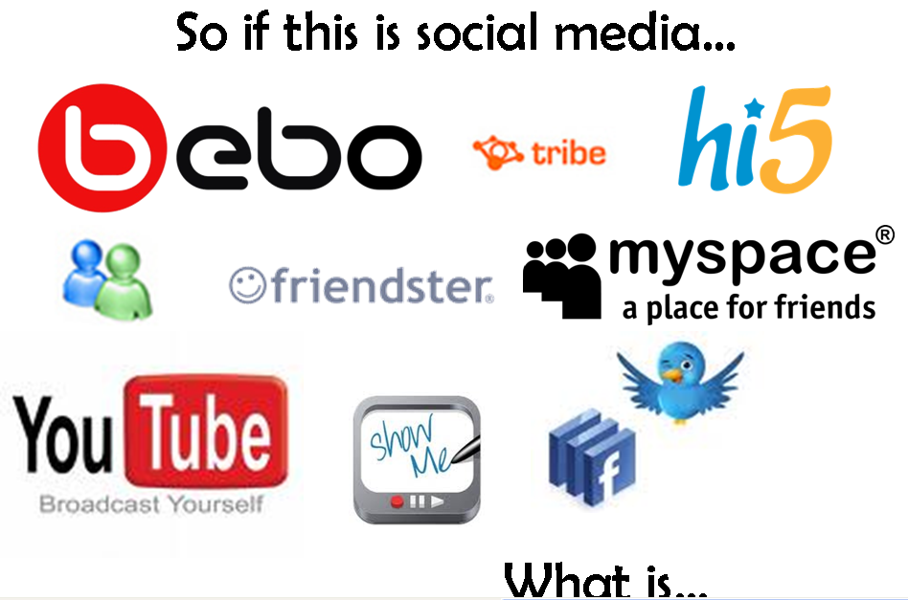
Question to consider...

Slide 35
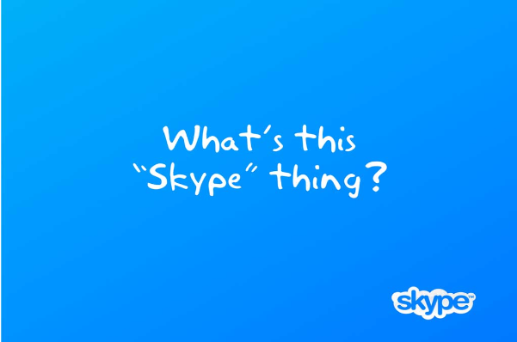
Skype: Social Media, Social Network, Social Tool?

Slide 36
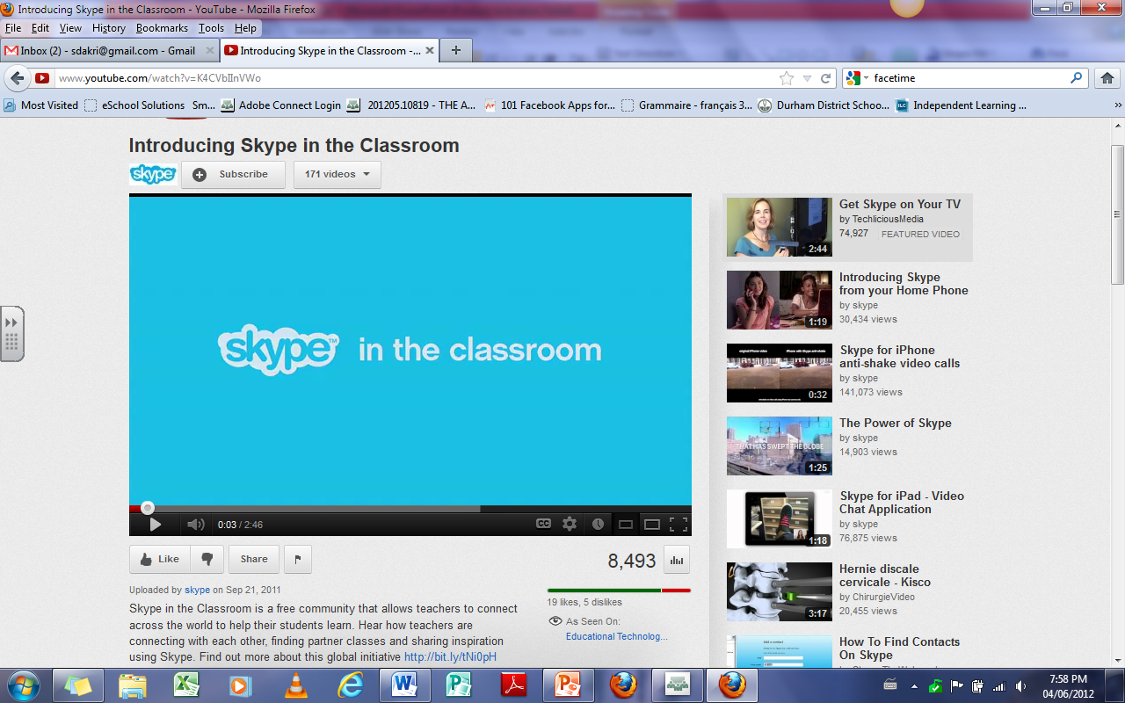
Skype Marketing to Teachers
http://www.youtube.com/watch?v=K4CVbIInVWo

Slide 37
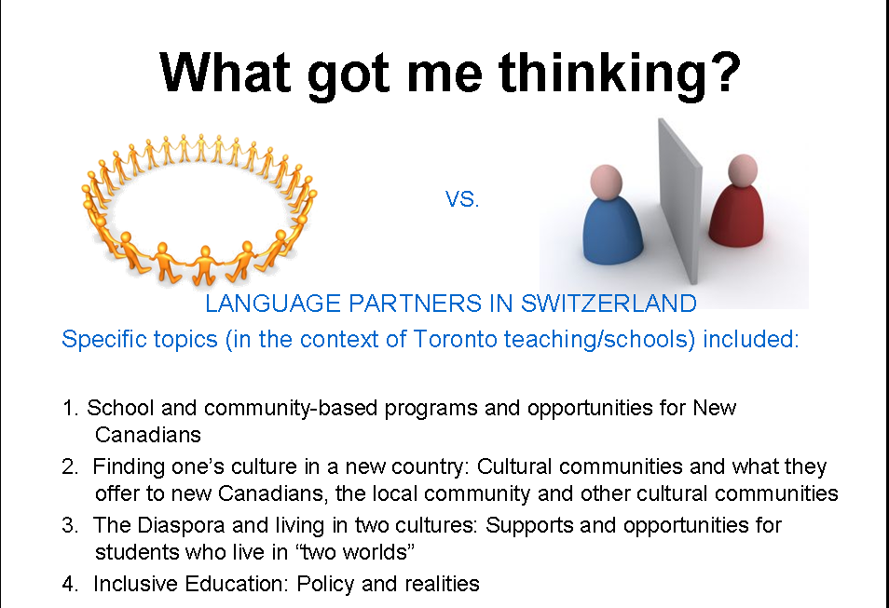
Heads Turning...

Slide 38

Thoughts on Skype in the classroom?

Slide 39

Examining the Use of Twitter in the Secondary Classroom for Students with Exceptionalities
For students with exceptionalities in the Secondary Classroom especially at the Grade 9 level the overload of high school can be too much.
Some of the difficulties they face are:
Organization
Memorization
Bringing Materials to Class
Understanding Content
Focus
Retaining Content
How can Twitt3er be useful to these students and help them to achieve success?

Slide 40

Organization & Memorization
Creating a class Twitter account can help to remind students of what is due, when it was assigned and when to hand it in.
Stop excuses
There is no need for them to write it in their agenda
They have a place they can refer to that is specific to the class
Although students shouldnt be having to memorize that often anymore, its particularly difficult for the students with special needs to memorize for tests. If pre-test questions are posted to help jog their memory, they may be able to retain more in the end.

Slide 41

Content - Retaining and Understanding
An amazing example of how to use Twitter in an English Classroom:
http://www.brevity.danikabarker.ca/Welcome.html
Twitter can be a platform for role playing and acting out different characters to avoid the embarrassing standing up in class and acting it out.

Slide 42


Student Engagement
Students are having trouble focussing in class? It's probably because the delivery method is boring.
Using social media like Twitter can really engage students who would otherwise not be interested in Shakespeare or ionic bonds or parabolas.

Slide 43

Results of the Survey
What were some surprising ways to use Twitter in your workplace?
How can we benefit from Twitter as educators?
How does it make our job harder? "The 24/7 worker"

Slide 44
THANK YOU!
Bavina, Candida, Roshni, Safia and Sasha
EDUC5103 - Online Technology in Education

