Slide 1
Towards a Meaning Centred Communication
Barnlund’s Transactional Model
Presented by:
Bavina, Safia and Roshni
Notes:
Bavina

Slide 2
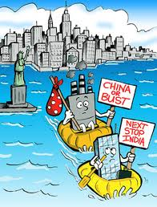
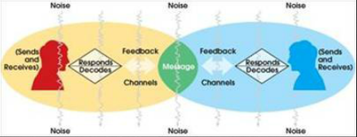
Case Study
Notes:
Bavina:
Our case study is based on outsourcing. Outsourcing refers to when companies make contracts with other companies to provide services that might be completed by in-house employees. Usually, there are financial advantages that comes from outsourcing.
Roshni:
Here is our case study:
Novelty Celebrations, decides to relocate their Canadian call centre headquarters to India by outsourcing their company. Novelty Celebrations makes its profit by selling novelty products to the U.S. and Canadian markets. These factors are most commonly considered and researched however very few companies, Novelty Celebrations included, did not consider the factors that could facilitate or hinder the communication process in this particular environment.
Novelty Celebrations management assigns two Canadian trainers for team building and training exercises in India. The trainers decide to save time and money by using the same training manual and presentations for their new team in India as they did for their team in Halifax, Nova Scotia. They assume that the method of delivery they used at the headquarters in Canada would work just as well for their counterparts in India. Unbeknownst to them, the team in India would have a harder time communicating than anticipated.
Safia:
The new employees in India are heavily screened and tested on their language abilities and conversational English skills. Most of them are educated young professionals starting their careers so the assumption is that they would have no difficultly in communicating with their North American clients. This theory was quickly tested and proven flawed when the trainees were testing their knowledge of the product line. No one realised that learning and knowing a different variation of English would be that complicated and prove to be such a challenge to the communication process. Further to this point, the team was confused about how to evaluate the situation as well as introduce easier methods to understand and implement changes.
The entire process of communication was thrown for a loop and no one quite understood what the problem was or how to fix it. The Barnlund Transactional model of communication serves as an exemplary foundation to analyse this scenario. If the main point of this model is that communication is a dynamic, process-oriented, meaning-centred relationships between the two participating parties, this theory will assist in resolving the clear and evident problems of communication in this case. The exchange of messages, exchange of values, transactions between both work environments and how these differences and parties communicate in response to their environments is evident in this model. The process of encoding and decoding the information is not as easy to understand nor is it a quick fix.
Bavina:
In terms of Barnlund’s theory of a global village, there are many advantages of outsourcing in this technologically enhanced global village but one of the main disadvantages are the misunderstandings between cultures. What may be appropriate in the Western culture can be offensive in an Asian culture. Therefore, when outsourcing, these cultural barriers of spoken words cause difficulties in understanding and interpretation of meaning. An example of this is with the term football. According to Americans, footballs are brown and egg-shaped. However, to most British colonized countries a football is round, and black and white. In the training session, the trainers were explaining the difference between an American football and a British soccer ball. During this interaction, the employees were unable to comprehend the concept of an American football and therefore the message sent (encoding) was misunderstood by the receiver (decoding). This is a typical setback of the global village as well as in an outsourcing environment as cultures are still learning to live and interact cohesively.

Slide 3
American Kitsch Explained to Indians
http://www.youtube.com/watch?v=bXo1mQIEXmY&feature=related
Notes:
Roshni:
Here is an example of the miscommunication that occurs in outsourcing.

Slide 4
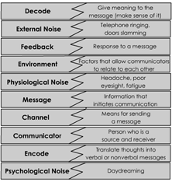
Discussion
How can you apply Barnlund’s Transactional Model of Communication to this scenario?
Notes:
Safia:
How can you apply Barnlund’s Transactional Model of Communication to this scenario?
Bavina:
Think about the misunderstanding of the word and the advice that the woman at the end gave to the American.

Slide 5
Educational Setting
Suppose you moved from Toronto to China to teach English to Mandarin speaking students. How can you relate your situation to Barnlund’s Transactional Model of Communication and our case study?
Notes:
Roshni:
Suppose you moved from Toronto to China to teach English to Mandarin speaking students. How can you relate your situation to Barnlund’s Transactional Model of Communication and our case study?
Prompts:
Think about multicultural classroom settings, ESL and FSL learning, communication barriers
(we can all lead this one)

Slide 6
Another Example of Outsourcing
http://www.youtube.com/watch?v=wA978v6oO9w
Notes:
Safia:
Here’s another example of outsourcing and the disadvantages of it in our society today.

Slide 7
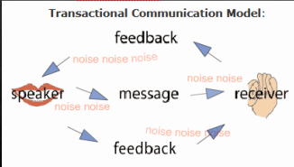
Discussion
How does this situation relate to what we have discussed in our presentation?
Notes:
Bavina:
In our overall presentation, we looked at how Barnlund’s Transactional Model of Communication relates to outsourcing. How does this video relate to what we have discussed in our presentation?
Prompts:
Think about encoding and decoding, misunderstanding

